Slide 1
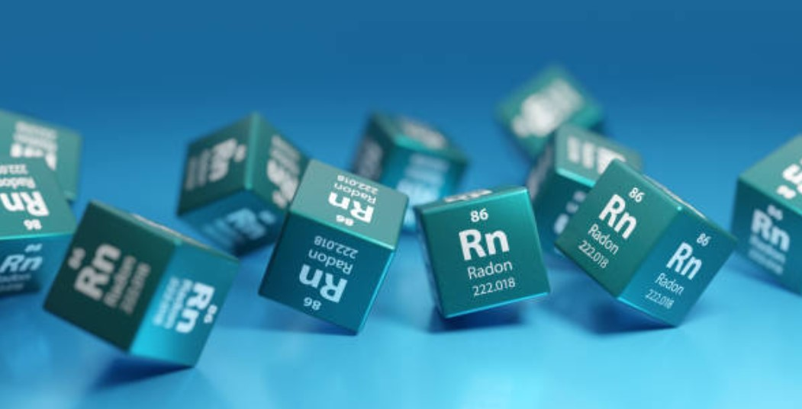
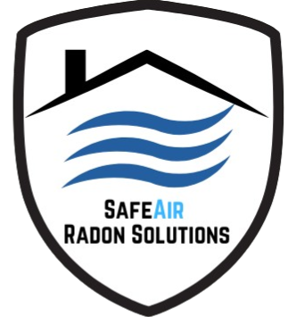
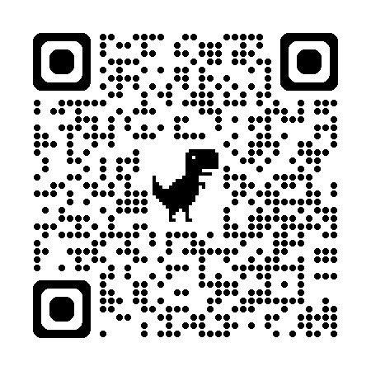
Safety Moment: Radon Awareness
Protecting Your Home and Health
Presented by SafeAir Radon Solutions

Slide 2
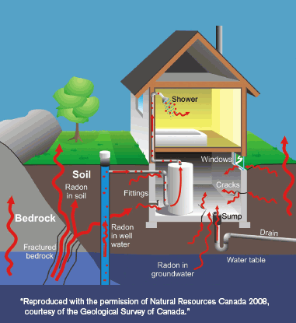
What is Radon?
Radon is a naturally occurring radioactive gas that comes from the breakdown of uranium in soil and rock
It enters buildings through cracks and openings in foundations
You cannot see, smell or taste radon — the only way to know your levels is to test

Slide 3
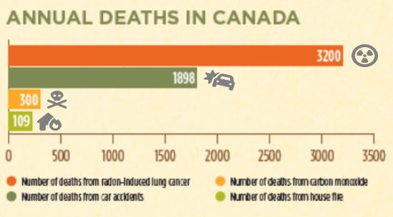
Why Radon is Dangerous
Radon is the #1 cause of lung cancer among non-smokers in Canada
It contributes to about 3,200 deaths per year nationwide
Kids breathe more, lungs still developing — radon hits them harder

Slide 4
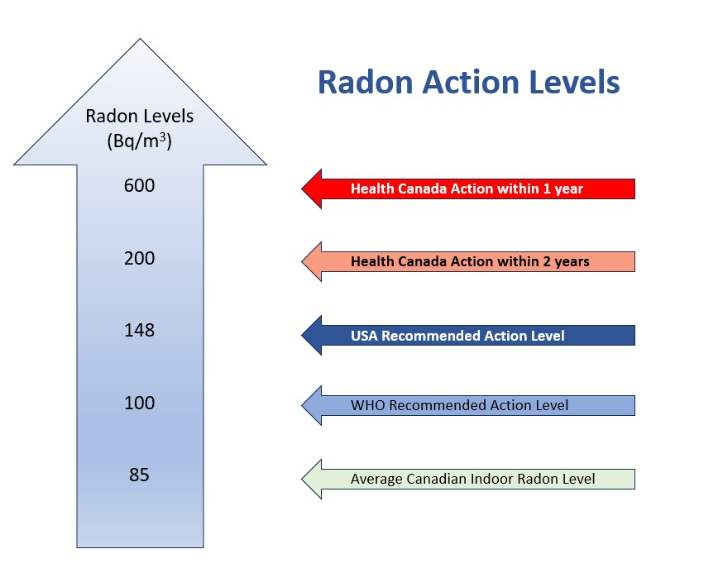
When to take Action?
Even more conservative than H.C. recommendation

Slide 5
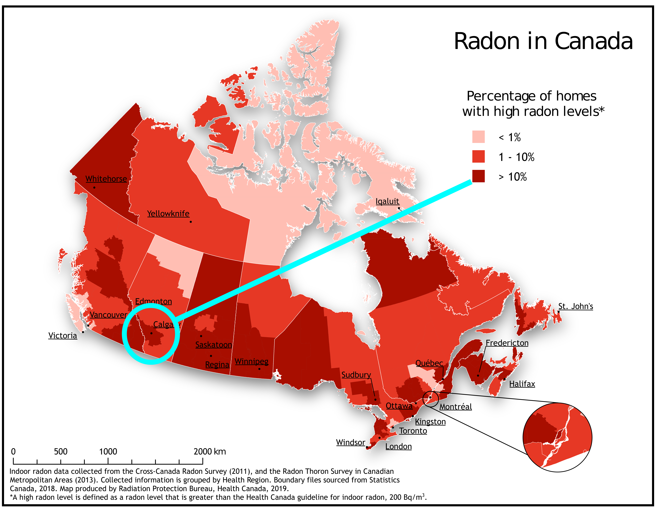
Radon in Calgary & Across Canada
The Prairie provinces have some of the highest radon levels in Canada
Due to our cold climate, homes are sealed tightly in winter —increasing radon buildup
In Calgary, 1 in 7 homes test above Health Canada’s guideline

Slide 6
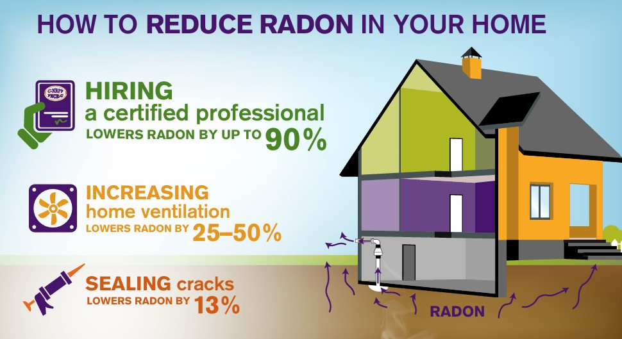
Testing for Radon
The only way to know your home’s radon level is to test
Long-term tests (90+ days) (i.e. Alpha Track Detectors) provide the most accurate results, while short-term tests offer quick insight into your current air quality
Winter is the best season to test as radon levels are typically at their highest and homes are sealed in against the cold

Slide 7
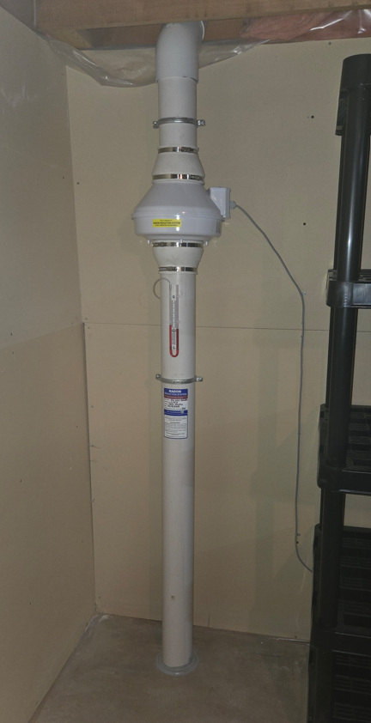
How to Reduce Radon Levels
Radon mitigation systems draw radon from under the foundation using a specialized fan and vents it safely out the side of the home
Sealing all accessible foundation cracks & openings is required
Professional mitigation is effective and often completed in one day
Post-mitigation targets for most homes to be below 75 Bq/m³

Slide 8
Summary Safety Moment
Radon is invisible, but its risk is real
Leading cause of lung cancer in non-smokers – 3,200 deaths in Canada annually
Alberta has some of the highest levels in Canada
Testing and mitigation protect your family and your long-term health
Take action! — because safety starts at home

Slide 9
About SafeAir Radon
Local Calgary-based radon measurement and mitigation experts
Certified by C-NRPP (Canadian National Radon Proficiency Program)
We offer free consultations, professional testing, and full mitigation services
Visit us at www.safeair-radon.ca

